Slide 1
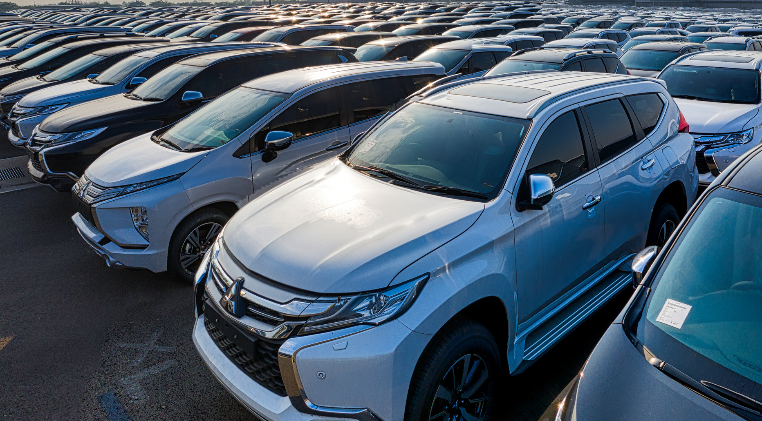

Automobile Strategic Grouping
Team M
Aakash R 20BCE1003
Subramanian Nachiappan N 20BCE1019
Saketh Kommareddy 20BCE1042
Sanjeet V 20BCE1050
Essentials of Data Analytics | Review -2

Slide 2
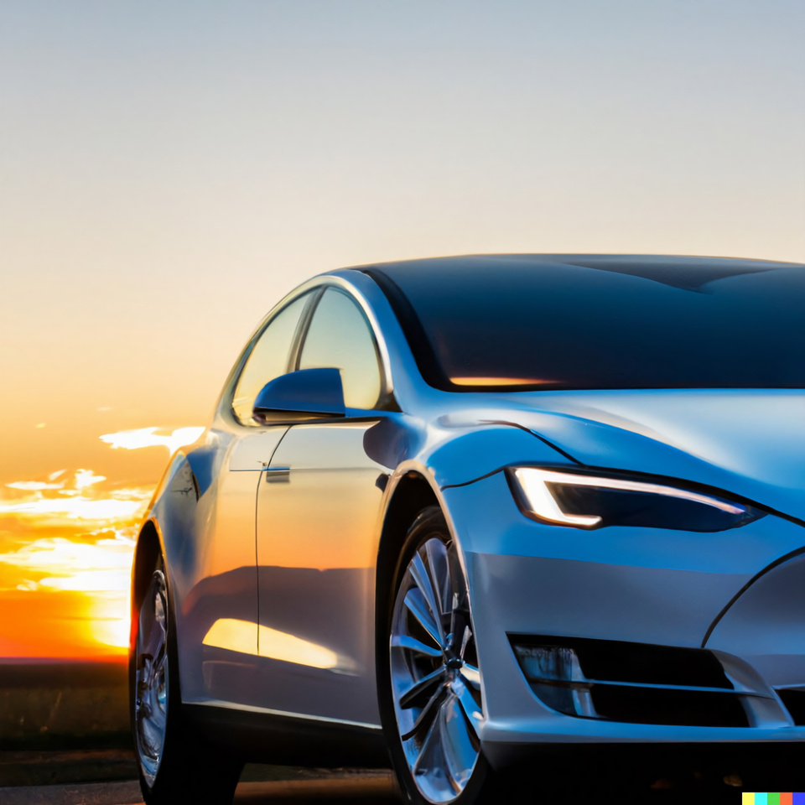
Abstract
The "Indian Automotive Strategic Grouping" is a data-driven study that groups different car models into strategic clusters based on their attributes such as price, mileage, seating capacity, etc. using clustering techniques. This helps to understand market dynamics, consumer preferences, and buying behavior, and can be useful for automobile manufacturers, dealers, and marketers to develop targeted strategies and improve product offerings. The study provides valuable insights into the Indian automotive market and its trends, which can be used as a reference for future research and analysis.

Slide 3
Research gap
Earlier studies implemented automobile brand segmentation much like a perceptual mapping technique in consumer behaviour studies. It helped brands understand their competitors in the market to gain a competitive advantage. Other automobile segmentations are mainly based on the vehicle dynamics such as length, width, height and seating capacity that gave rise to various vehicle segments such as 'Sedan', 'Hatchback', 'SUV', etc. This project aims to go deeper into automobile segmentation by helping brands identify competitive car models of other brands.

Slide 4
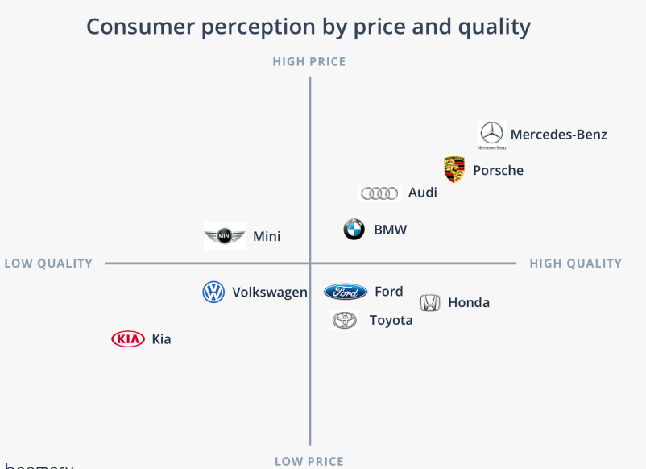

Slide 5
Proposed Solution
Our model uses clustering which is a unsupervised machine learning technique. This data-driven approach groups car models based on the attributes like brand, price, other features and identifies different strategic grouping of car models. These groups are then studied to understand consumer behaviour and market dynamics. Finally, we determine the best car for each group based on its features, and recommend the car that matches the customer's needs by identifying the group with the most matches.

Slide 6
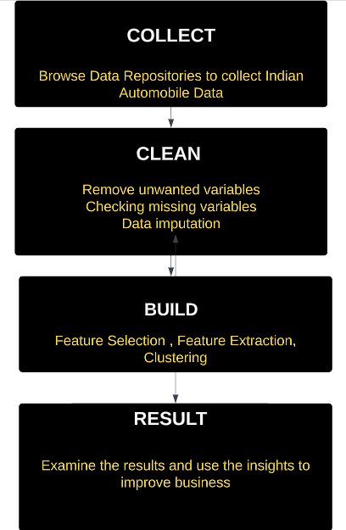
Arcitecture

Slide 7
Module Description
Data Collection
Data Cleaning and Preprocessing
Exploratory Data Analysis
Feature Selection
Model Building & Insights
Visualization
Descriptive Statistics
Correlation
PCA
Information Gain
Identify appropriate dataset
Gower's Distance
Partitioning Around Medoids
Cleaning features
Imputation
Transforming Features to apt datatype

Slide 8

M1: Collection and organization of data
The process of gathering and analysing accurate data from various sources to find answers to research problems, trends, probabilities, etc., to evaluate possible outcomes is known as data collection. First, we find all the possible datasets that we can use for the project which may include industry reports, market surveys, government publications, and company websites. We will then analyze the data which provide detailed information on car models, their attributes, and market trends. Through discussion we identify the problem statement and finalize the questions which can be answered at end. Accordingly we will select the dataset which meeting our requirements and satisfying our problem statement

Slide 9

M2: Data cleaning and Imputation
First we will analyze the dataset and find the attributes which can be converted to numeric by removing the units attached to it. We are removing the attributes which are having NA values greater than 10% and checking for the class of the attribute so that we can imputing it accordingly. The numerical attributes with NA values are selected and are imputed using Mean and categorical attributes with NA values are selected and imputed using the Mode. Finally we can look at the correlation matrix for numerical attributes to get the overview of the variables and know how they are related to each other and remove the attributes which are having a high correlations.

Slide 10
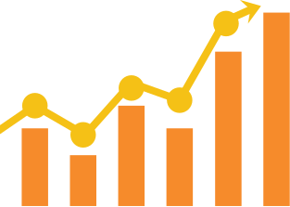
M3: Exploratory Data Analytics
Exploratory Data Analysis (EDA) is an approach to analysing data using visual techniques. It is used to discover trends, patterns, or to check assumptions with the help of statistical summaries and graphical representations. It plays very important role in unsupervised learning. We need to find the various variants of the cars for clustering the data to identify its competitor. We will Explore and Visualize all the possible graphs that can be drawn.
Search Results
Main results

Slide 11

M4: Variable Selection
From the plots we have drawn in the previous module, we will infer a lot of things. For example, length of the vehicle is directly related no of seats. We must decide upon which variable will be using in the construction of a clustering model, and that should in turn help in grouping the various car models accurately. We also use information gain for selecting the categorical variable that are good predictors of the car models. Principal Component Analysis is used to extract the numerical features that explain a majority of the variance in the data

Slide 12
M5: Model Building
In this module we construct the machine learning model using clustering, a unsupervised learning technique. We use the Silhouette technique to determine the optimal number of clusters, with gower's distance as the distance metric. Since the dataset contain both numerical and categorical features, we use the Partitioning Around Medoids (PAM) clustering to segment the car models.

Slide 13
Reference
[1] K. Noor and S. Jan, “Vehicle price prediction system using machine learning techniques,” International Journal of Computer Applications, vol. 167, no. 9, pp. 27–31, 2017
Mou, A. D., Saha, P. K., Nisher, S. A., & Saha, A. (2021, February). A comprehensive study of machine learning algorithms for predicting car purchase based on customers demands. In 2021 International Conference on Information and Communication Technology for Sustainable Development (ICICT4SD) (pp. 180-184). IEEE.
Dave, M., & Gianey, H. (2016, November). Different clustering algorithms for Big Data analytics: A review. In 2016 International Conference System Modeling & Advancement in Research Trends (SMART) (pp. 328-333). IEEE.

